Slide 1
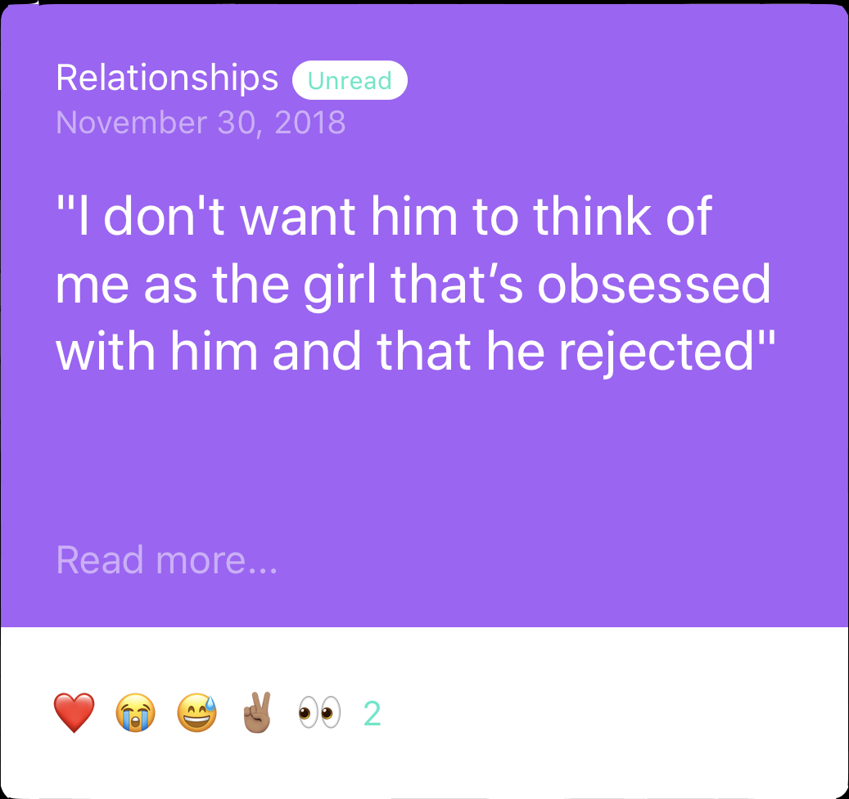
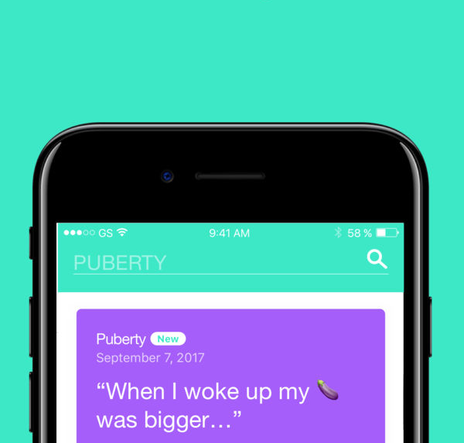

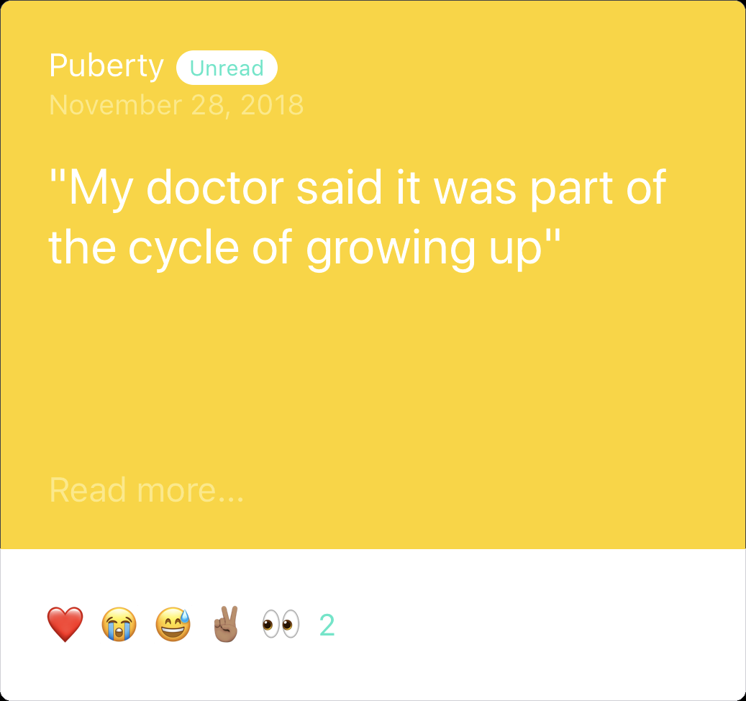
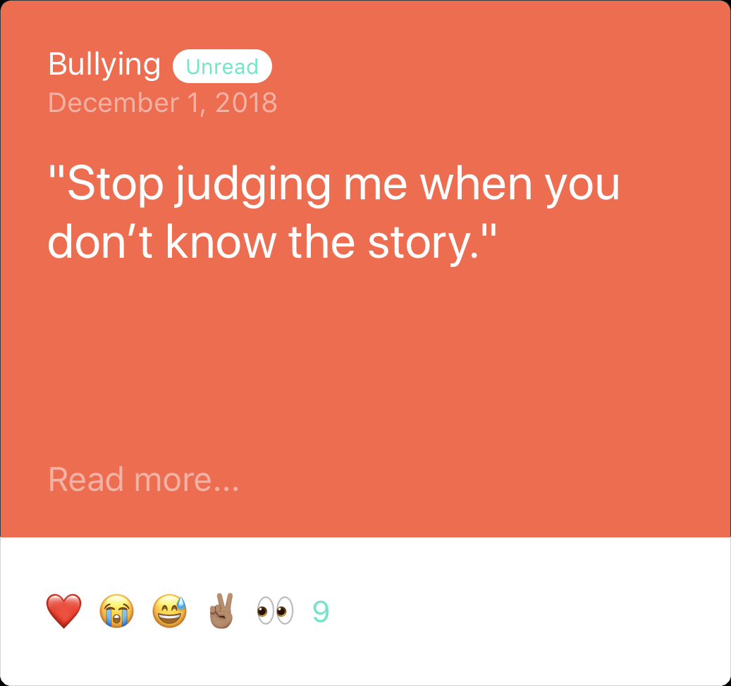
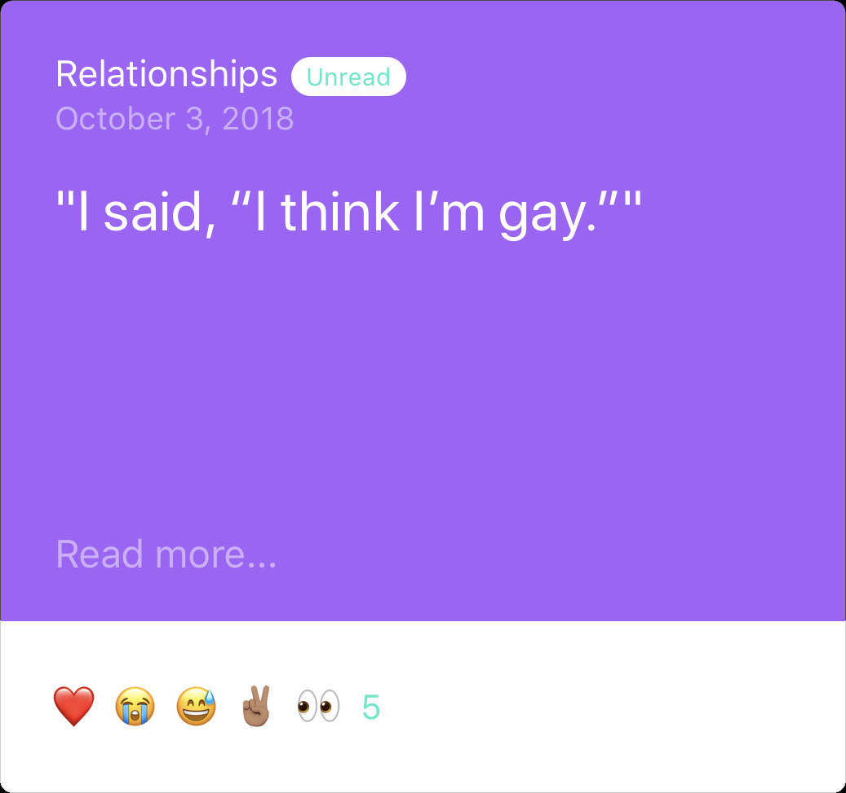

Slide 2
At a Glance
01
Most Contributors are Female
28% male, 1% non-binary
68%
02
Bullying Stories highest for Non-Binary
32% male stories, 20% female stories
42%
03
Majority of stories about Relationships
50%
Male Stories highest for Puberty
27% of Bullying, 24% Relationships
37%
04
Subjects Discussed
Relationships
Puberty
Bullying

Slide 3
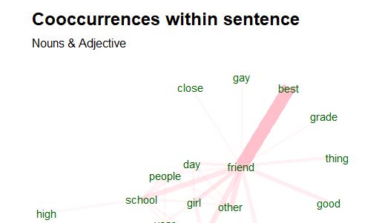
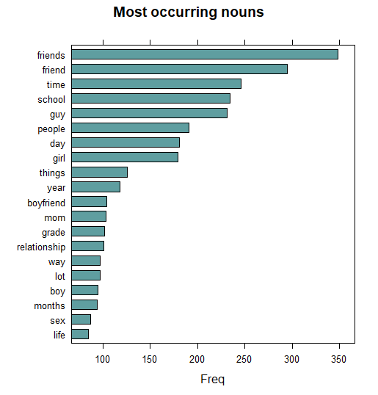
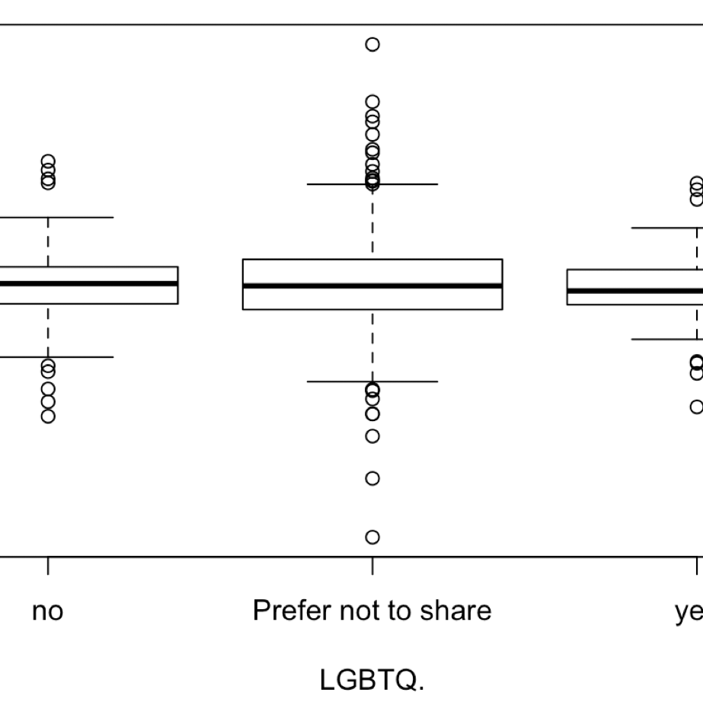
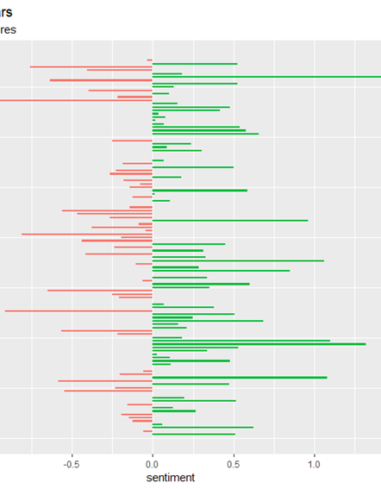
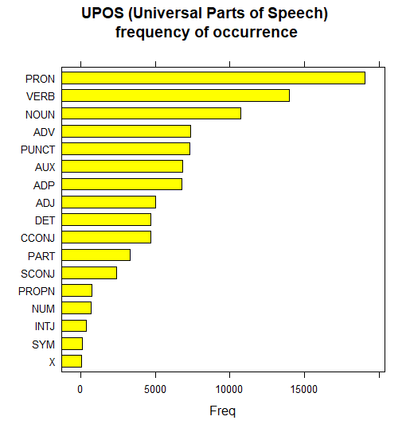
Initial Analyses: Not as useful for our client

Slide 4
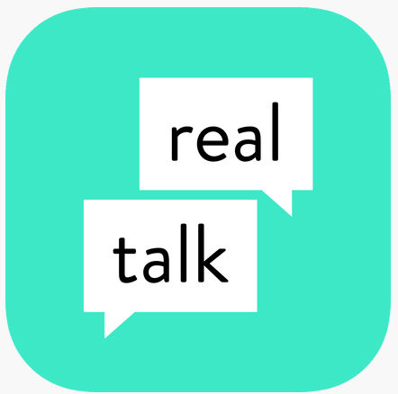
Client Feedback
RealTalk Selects and Publishes Stories
Teens Submit Anonymous Stories
RealTalk Creates Resources & Prompts
Publication Scoring and Alerts
Automate Parts of Scoring
Gauge Story Cohesiveness
Flag Strong Negative Emotions
Story Text Analysis
Popular Topics/Keywords
Differences by Demographics in Emojis, Readability, Topics Discussed
Are there regional trends/clusters of states that emerge from the data?
Can you tell us about frequent terms are being brought up by sub-group? By topic? By region?
What is the average reading level of these stories? By sub-groups?
Are published articles over-represented by any sub-groups?
Where are the most LGBTQ stories coming from? What is the sentiment in those states/regions?
Better Understand Content
Streamline Review Process
Tailor Educational Resources
Readability Score
Emojis
Keywords
Automate Parts of Scoring
Gauge Story Cohesiveness
Flag Strong Negative Emotions
Identify New Topics/Keywords
Reach Appropriate Audiences
Observes Trends in Usership

Slide 5
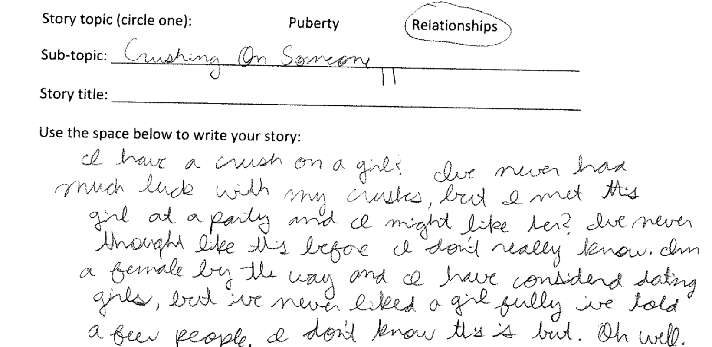

02
01
Google Cloud Speech API
Handwritten to text - ABBYY OCR
90%
1450 Stories
10%
App Data
Handwritten

Slide 6
Speech to Text Algorithm
Topics are User defined
Age
Gender
Topic
Story
Repeat Process
Audio Format:
44100 Hz,
Wav file,
Mono channel
Converted to Data Table

Slide 7





Data Cleaning
The essential steps before every possible analysis
Combining & Rearranging
Some of our data has the text separated into different columns. We have to combine and rearrange before anything else.
Selecting & Renaming
Not all of the columns of data are useful to our analysis. We have to select and rename them.
Correcting Spellings
Acronyms and misspellings are common in our text (which comes from teenagers). By building a dictionary for it, we can correct the spelling.
Stemming, Stopwords, etc.
After correcting spelling, we can do the old-fashioned data pre-processing skills to our data.
better understand content
Notes:
Start with Acronyms (scraped from online) – bc could be seen as spelling errors
Used a scraped set of acronyms from the web to turn acronyms into words ex. Idk for I don’t know
Slang/Ignore list that is user defined– ex. Bc – because, bj- blow job
Spelling code- finds errors based on English dictionary--- then uses a point system to suggest several choices, and the “best” choice is the one with the smallest score (fewest changes to find the correct word)

Slide 8
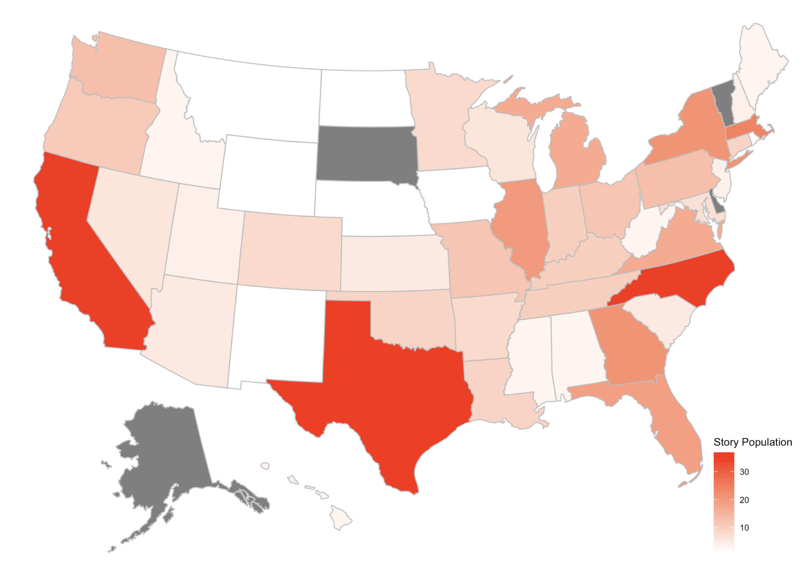
20.6%
Midwest
18.6%
West
16.9%
Northeast
11.1%
Southwest
32.8%
Southeast
Map on Sample Population
Basic view of sample
population on states.
better understand content

Slide 9
Emoji Analysis
Overview emoji usage for the whole data set
better understand content
http://kt.ijs.si/data/Emoji_sentiment_ranking/emojimap.html

Slide 10
Emoji Analysis
Usage by gender
better understand content
Female
Male

Slide 11
Emoji Analysis
Usage by subjects: bullying, relationships, puberty
Bullying
Relationships
Puberty
better understand content

Slide 12
Personal disclosure
By subgroups and subjects
Disclosure of personal information similar between genders, with the exception of LGBTQ status
Disclosure of LGBTQ status varied by subject and was most frequently disclosed in bullying story
Disclosure of zip code was most frequent for puberty stories
Contributors most likely to report phone number if submitting stories about bullying
tailor
educational
resources

Slide 13
Readability level
What failed…
The Flesch–Kincaid readability tests are readability tests designed to indicate how difficult a passage in English is to understand. There are two tests, the Flesch Reading Ease, and the Flesch–Kincaid Grade Level. Although they use the same core measures (word length and sentence length), they have different weighting factors.
Score | School level | Notes
100.00-90.00 | 5th grade | Very easy to read. Easily understood by an average 11-year-old student.
90.0–80.0 | 6th grade | Easy to read. Conversational English for consumers.
80.0–70.0 | 7th grade | Fairly easy to read.
70.0–60.0 | 8th & 9th grade | Plain English. Easily understood by 13- to 15-year-old students.
60.0–50.0 | 10th to 12th grade | Fairly difficult to read.
50.0–30.0 | College | Difficult to read.
30.0–0.0 | College graduate | Very difficult to read. Best understood by university graduates.
better understand content

Slide 14
Readability level
What failed…
"incomplete people at school would say i was " too fat" or i had "no ass" and i need to get braces cause i have "roller coaster teeth" or i was "to ugly for anyone to love" that i am a "bitch and a slut" and then my dad would blame everything on me and say that i am worthless "and i am a disrespectful and lying child and i need to reality check cause i am out of line" at first it didn't bother me but one day i started to believe it , i started to think that i was a worthless human being, that i offer nothing to the world one day i was so sick and tired of feeling this way so i stopped it all, i wanted to stand up to all them and i did , now i don't see my dad. , i don't get bullies anymore”
Flesch. Kincaid Score:
25.82
"My friend They tripped me every time because they knew I was clumsy. It made me feel very bad One day I saw it coming and I stepped to the side and he missed me. ”
Flesch. Kincaid Score:
6.94
better understand content

Slide 15
Readability Algorithm
Average grade readability of 2.88 Range[SS1 to 5.90]
Need further information from subject matter expert to assess success of our approach
Kindergarden Level
Grade 3
I do not like girls. They are mean.
Grade Levels 1:8
Unrecognized Words
User Defined
Grade
Scores
Grade 5
I feel like so many people don’t really know what asexuality is, so telling anyone who doesn’t already know what it is is always awkward. I’m also always afraid that a future girlfriend will come to resent me for it.
Academic Words
SAT words
Frequency
GRE Words
better understand content

Slide 16
Sentiment Analysis
Positive Sentiment
This boy. His cute as fuck. 17. And perfect. At least to me. We dated for a while and broke up. Continuing to talk until we told each other that we still like each other. He told me he is mine And I think that’s good? I was extremely happy
Negative Sentiment
All I’ve ever wanted was love. I was in love with the idea of love forever. But love doesn’t love me. I have nobody.
Emotion Mix
My ex cheated on me. I thought the world is going to end. Two years later I met another guy.. He is different. I love him. I so happy.
Formulas:
Sentiment Score: Σ (sentence sentiment scores)
Emotion mix: |sentiment score| - Σ |(sentence sentiment scores)|
better understand content

Slide 17
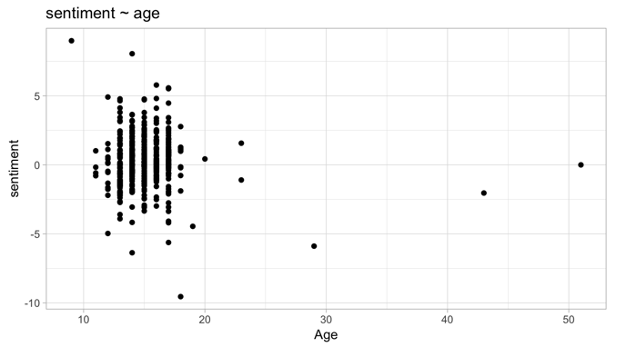
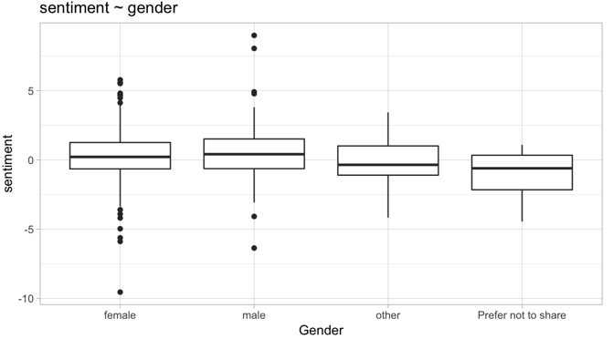
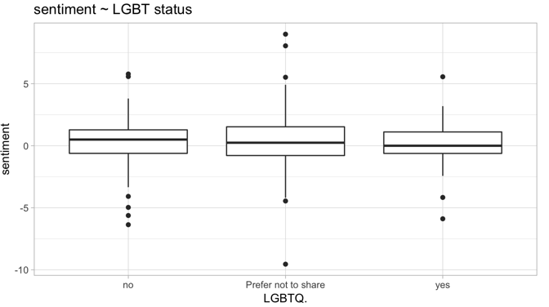
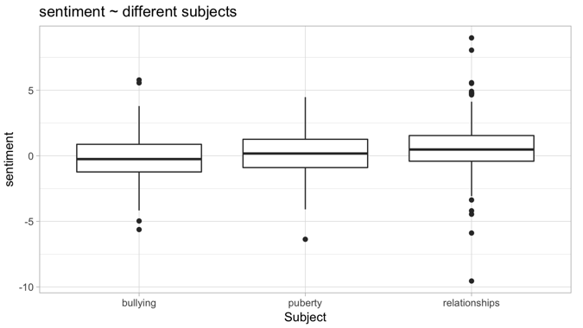
Basic Demographic Information
Average sentiment score on Age, Gender, LGBTQ status and Subjects
better understand content

Slide 18


KEYWORD SEARCH
ALGORITHM
The objective is to pick the important words in the story that highlights the main idea of the story.
Relationships
E.g. Parents, Sister, Friend
User Defined Words
E.g. Cheated, coming out, Penis,
Health keywords, support keywords
High Sentiment words
E.g. Angry, Hate, arghh
Social Media words
Eg. Facebook, Snapchat
High Frequency words
Eg. LGBTQ, love
tailor
educational
resources

Slide 19
Examples of Keyword Search
01
02
03
04
girl, school, rape, hit, car, worthless
boyfriend, sex, time, thankful
parent, phone, found, come out, proud
fun, bald, head, nephew, cancer, hair, blood, judging
this girl in my school; they told me they were going to rape me. i was so scared. i also got told they were going to hit me with a car and stuff like that; it made me feel worthless; nothing
My boyfriend asked me if I was ready to have sex. I had already been thinking about it, and I said yes. However, he kept asking me if I was ready, like ten times. I told him yes each time. It was important to him that I was ready, and I was really thankful for that.
I didn't get the opportunity to come out; My parents went through my phone and found my letter; But i take pride in it because if that didn't happen, I don't know where I would be haha!; So no matter however you may have come out, be proud of it! Be proud of owning who you are and changing the norm!
People always stare at me and make fun of me because of my bald head. I choose to be bald because my 9 year old nephew has cancer so by supporting him I shaved my head with him. Yeah being bald might not be my ideal hair style but I would do anything for my nephew. I even give blood to him when he needs it. Stop judging me when you don’t know the story.
tailor
educational
resources

Slide 20
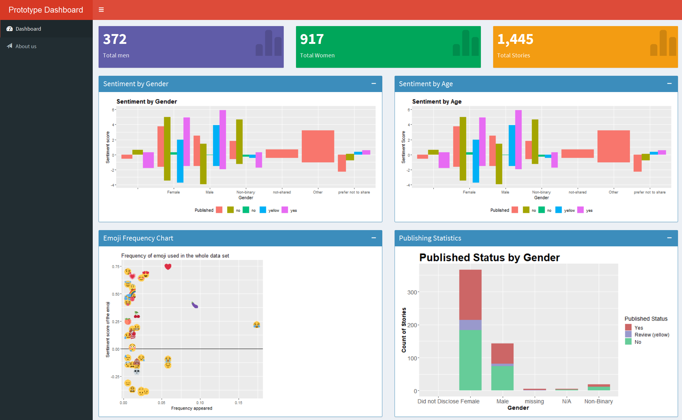
Dashboard
tailor
educational
resources

Slide 21

Publishing Rules
How detailed is the story?
Is the story cohesive?
Is the story written in teen-friendly language?
Does the story use vocabulary/phrases that can potentially link to additional content?
Does the story answer the prompts?
streamline
review
process

Slide 22

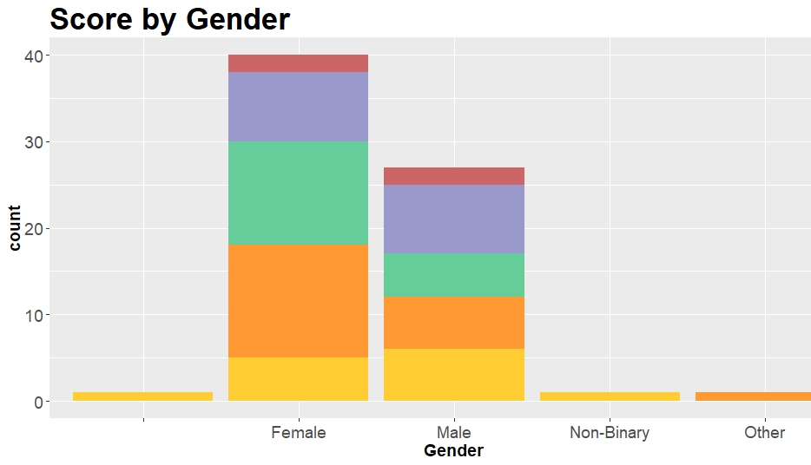




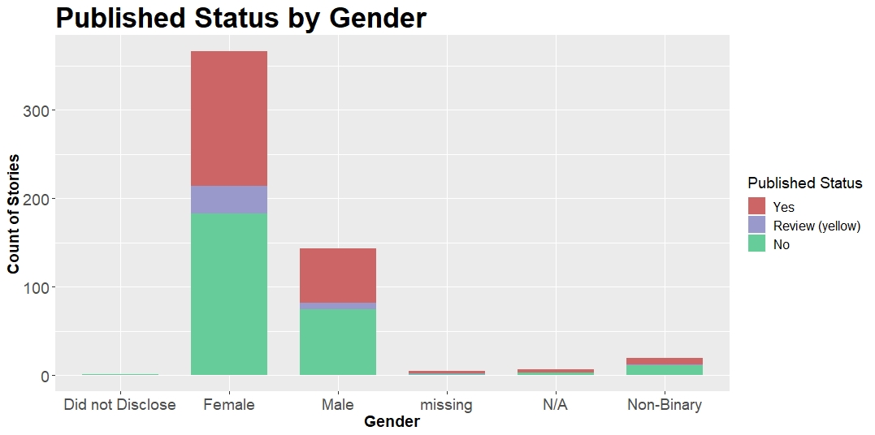

Attempts to replicate publishing rules:
Keywords based on subject areas can tell if discussing prompts and if the story is relevant to educational content
Keywords and word count may help establish level of detail
Dictionary for “crudeness” can help assess if language is teen-friendly for publishing
Logistic Regression using LIWC measures was not yet conclusive, but could be used to create a method of determining cohesiveness
streamline
review
process

Slide 23

In Conclusion, our analysis allowed Real Talk to
01
Understand what
different subgroups
talk about most
Females tend to talk more about relationships, while males tend to talk more about puberty
02
Identify individuals who may
be reaching out for support
03
Remove acronyms and misspellings & quantify emojis for richer analysis
Individuals who wrote about bullying and those that reported LGBTQ status were most likely to share personal information, such as phone number, which may be a sign of reaching out
Teenagers use emojis to talk about body parts and uncomfortable topics, and gender trends similar to that of texts
04
Take the first steps in automating parts of their review and publishing process
Keywords will help identify popular topics for future educational content
Readability and LIWC scores may assist in establishing more efficient publishing standards

Slide 24
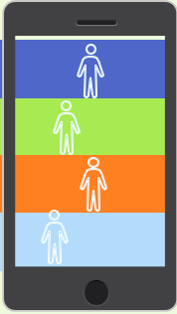
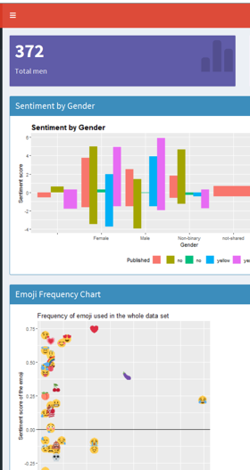
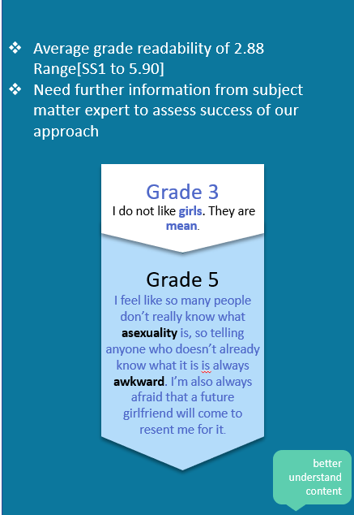
Next Steps
A dashboard will be a useful tool for Liz and her colleagues, which we hope to continue to develop so their team can continue to monitor and understand their data and tailor educational resources
Tools to streamline their story review process may need additional support and refinement, which will require input from Real Talk and subject matter experts
LIWC, Topic Modeling, and Text Networks were not conducive for this small corpus, but as the amount of stories grows, we have created tools for the next group of students they work with to utilize

Slide 25
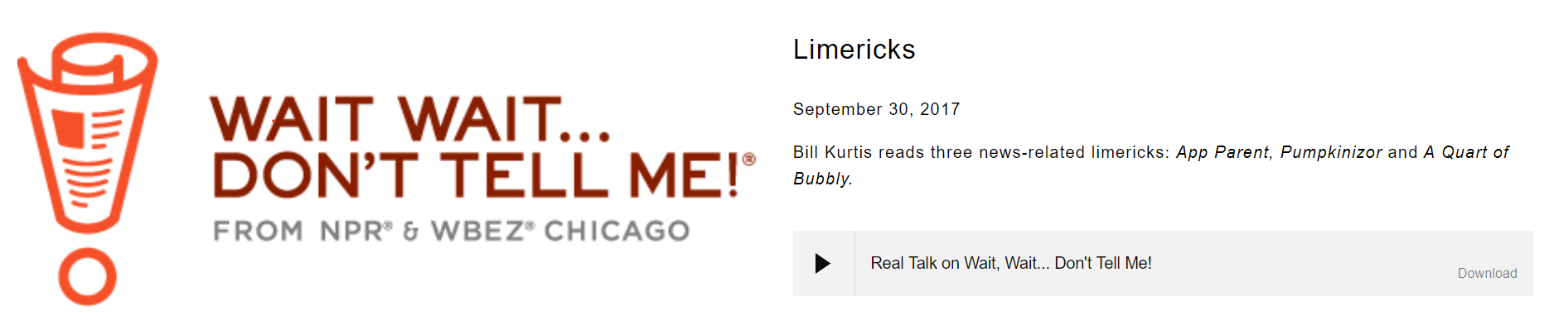

Questions

